Slide 1


SMART INDIA HACKATHON 2025
TITLE PAGE
Problem Statement ID – 25102
Problem Statement Title – AI-based drop-out prediction and counseling system
Theme- Smart Automation
PS Category- Software
Team ID-
Team Name - VIDYA

Slide 2
IDEA TITLE
VIDYA
SOLUTION
Predictive AI model for reducing dropout rates
Model that can accumulate and interpret the various academic verticals of the students
Analyses performance and past trends
Identifies risk of droping out for different students
Gives suggestions for mentors and timely alert to guardians regarding student's academics
The user interface is an interactive and intuitive dashboard
UNIQUE VALUE PROPOSITIONS(UVP)
Offers zero cost solution to schools.
Colour coded interface for intuitive design
Requires minimal training for mentors, guardians and students
Can handle data for a large number of students
Helps in early intervention

Slide 3
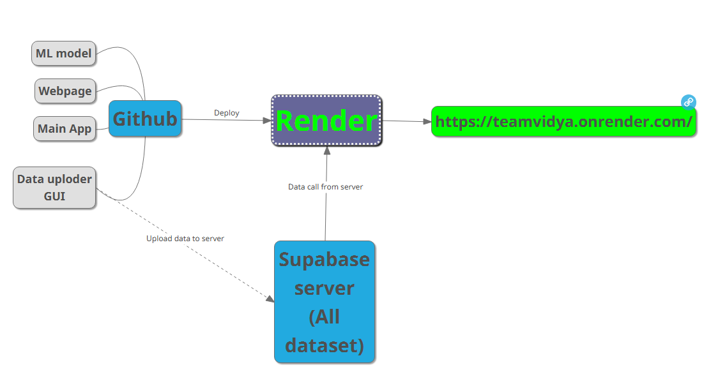
TECHNICAL APPROACH
VIDYA
Technologies used:
Python
Html
Supabase
Render
Github

Slide 4
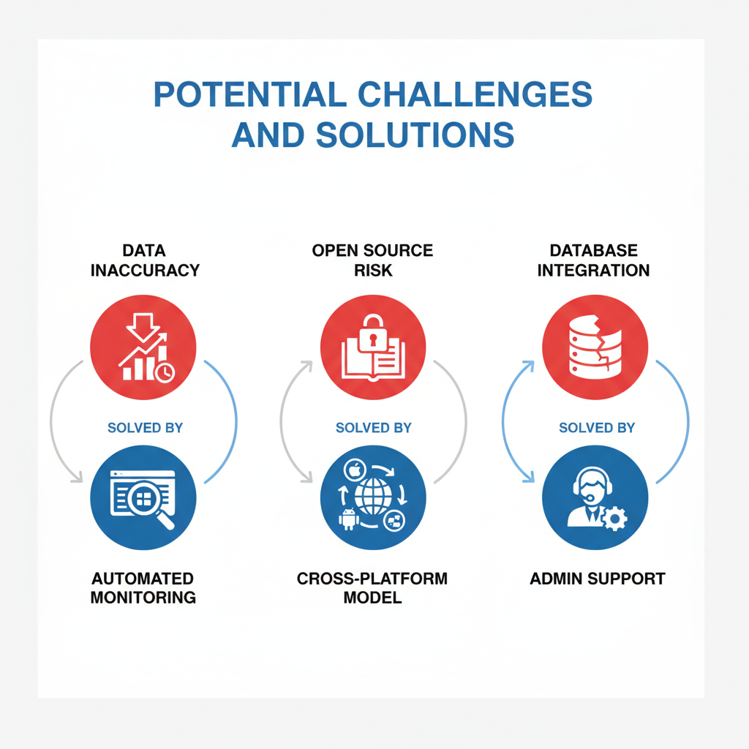
FEASIBILITY AND VIABILITY
VIDYA
FEASIBILITY
Zero cost and minimal training
Cloud based
No infrastructure requirement
Accessible on mobiles, computers, etc.
User friendly
AI based(determines trends on its own)

Slide 5



VIDYA

Slide 6
RESEARCH AND REFERENCES
VIDYA
Getting Started | Supabase Docs
Python GUI Programming: Your Tkinter Tutorial – Real Python
Machine Learning with Python Tutorial - GeeksforGeeks
First time Render deployment

